Slide 1



UNIT 3; People and places
Self-check 3

Slide 2
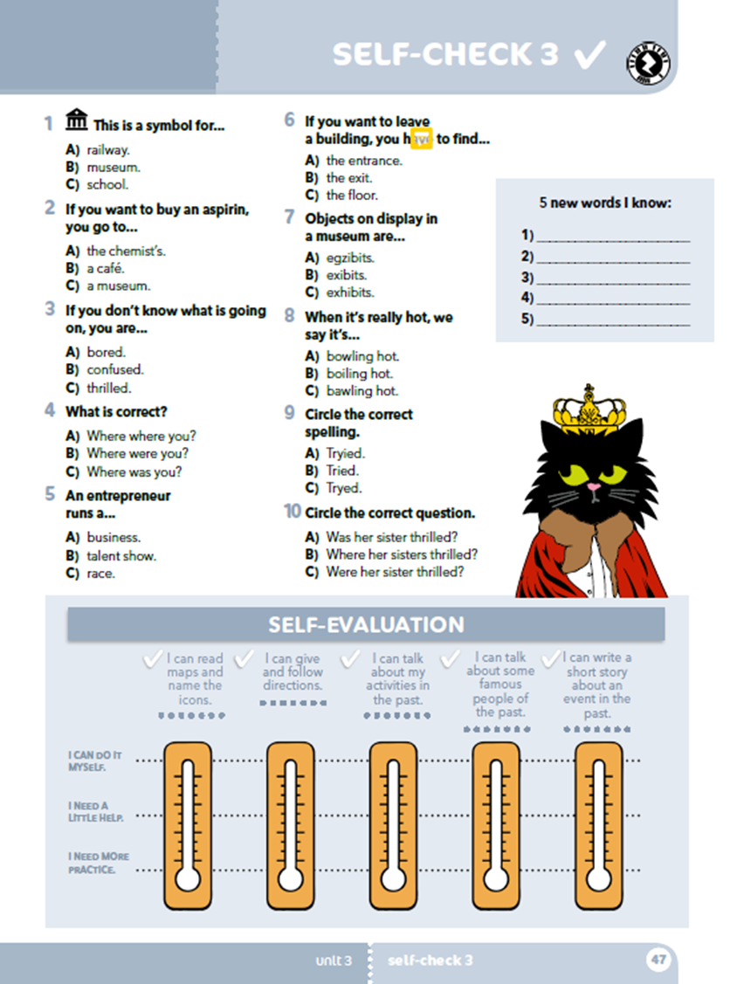
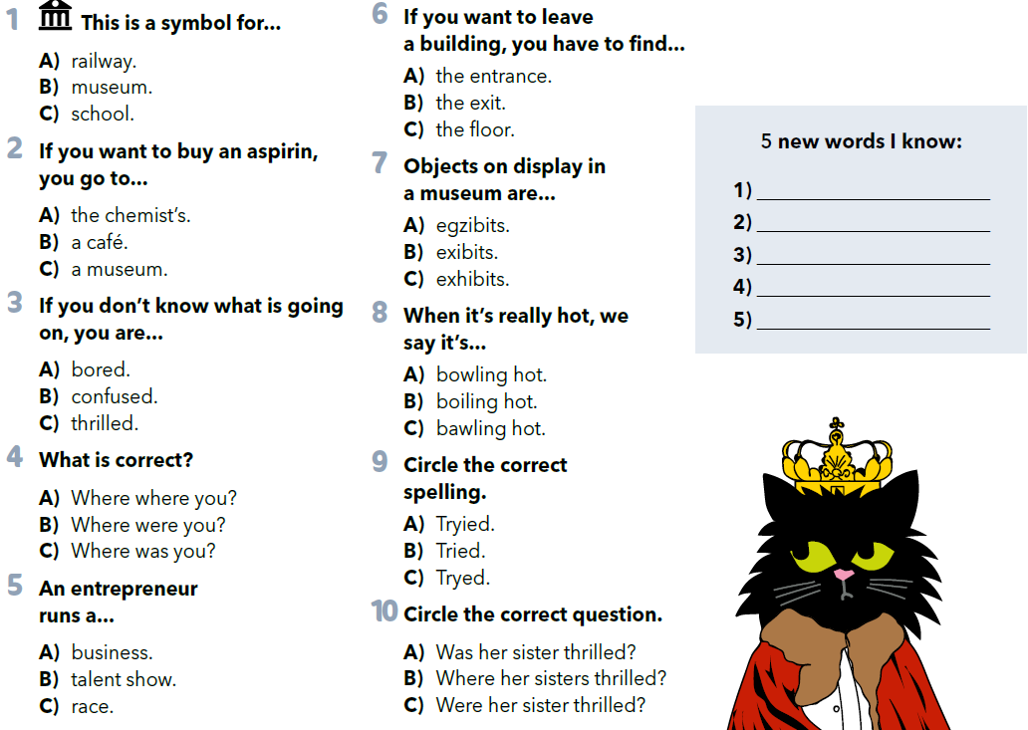


Read the questions and circle the correct answer.
Write 5 new words you know.
Practise: https://wordwall.net/play/899/783/718

Slide 3
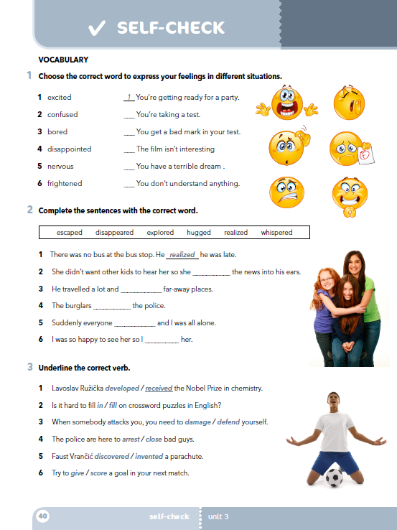
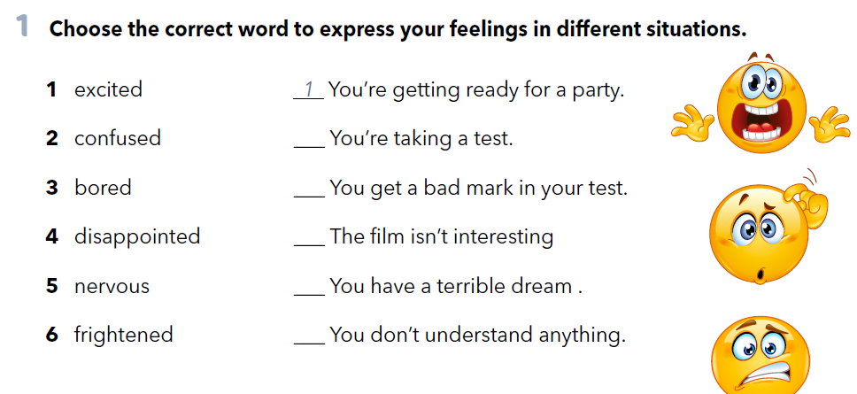
Workbook, p. 40
5
4
3
6
2

Slide 4
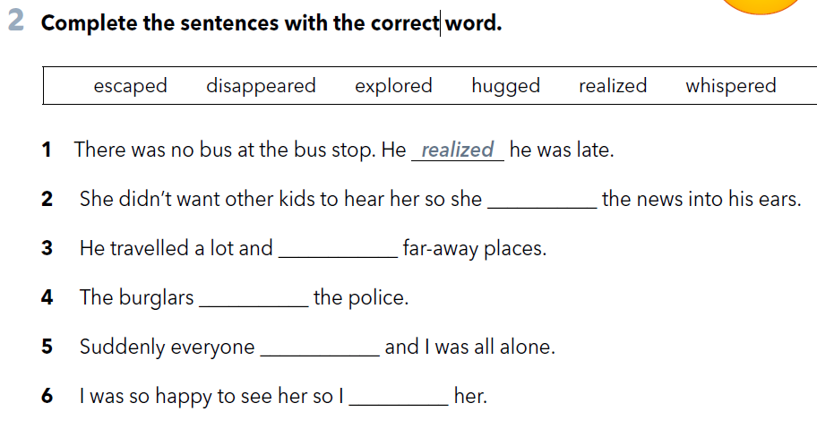
whispered
explored
escaped
disappeared
hugged

Slide 5
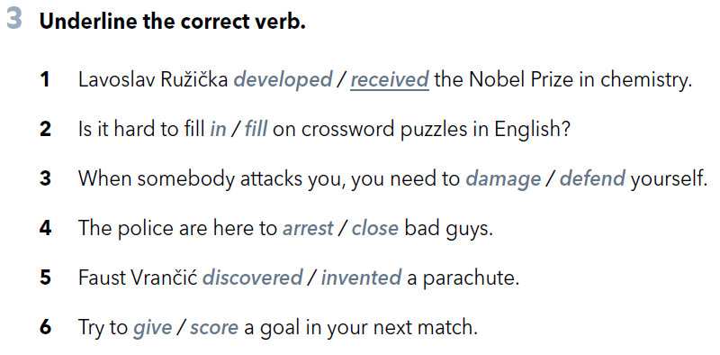


Slide 6
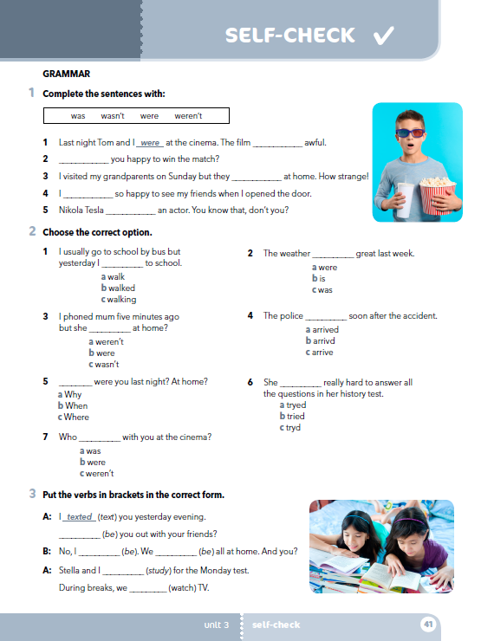
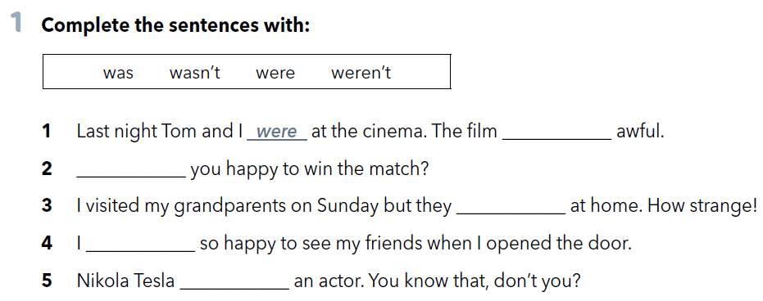
was
Were
weren’t
was
wasn’t

Slide 7
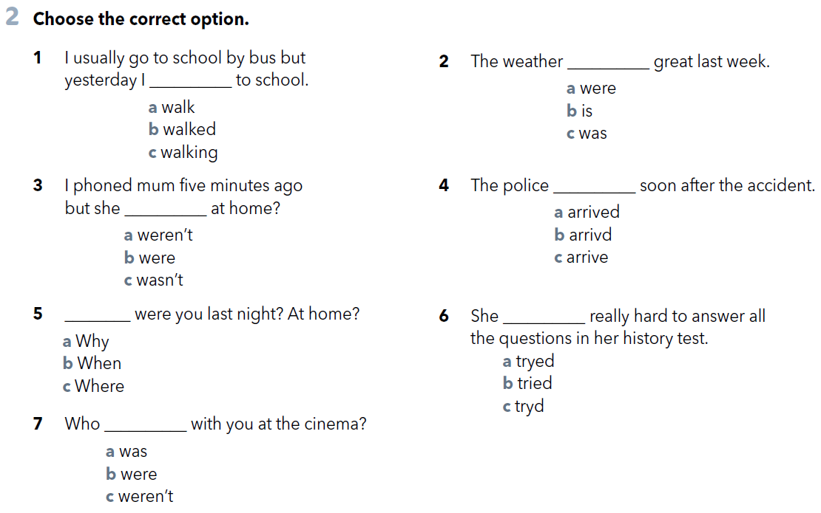

Slide 8
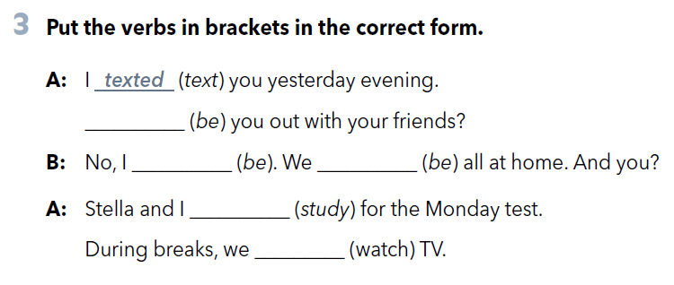
Posjeti aplikaciju Meme Generator na stranici https://imgflip.com/memegenerator u kojoj će izraditi ‘meme’ s bilo kojom temom iz treće lekcije. Prijedlog tema: - izgubljeni u novom gradu, - neuspjela rođendanska zabava, - neugodna situacija na obiteljskom ručku, - susret s novom izvanzemaljskom vrstom, - neuspjeli znanstveni pokus, - razgovor muzejskih izložaka, - bolovi u trbuhu u nezgodnom trenutku, - neugodan susret.
Were
wasn’t
were
studied
watched

Slide 9
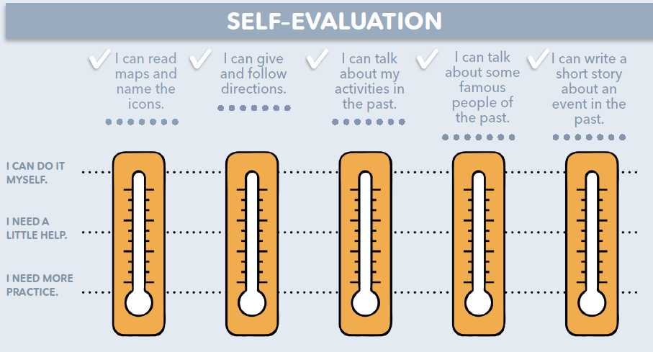
mogu sam, jasno mi je
trebam malo pomoći
moram još vježbati

